Slide 1
Introduction to Arduino & Microcontroller Programming
Coding Bootcamp @ Belkin
Apr-2019

Slide 2

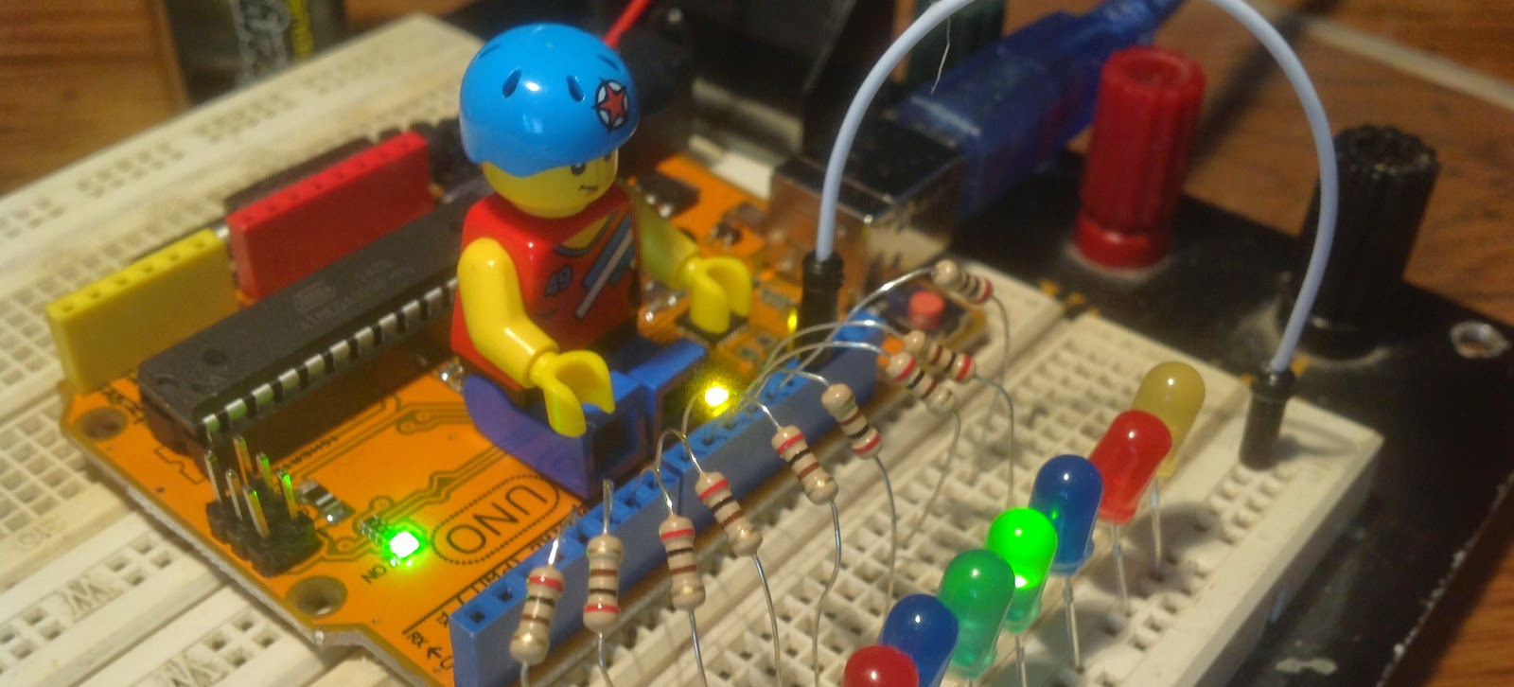
What is Arduino?
A microcontroller board ( a small single chip computer )
A USB connection for programming and basic communication
Has a number of connections that can be wired to external electronics for gathering data or control (GPIO).
User friendly opensource hardware, software, and tools designed for learning programming and electronics

Slide 3
Meet Arduino Uno

Slide 4
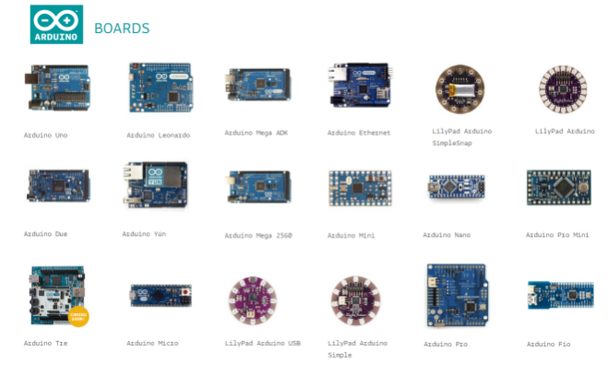
Something for Everyone
There are over 800 Arduino compatible boards that can be programmed with the Arduino IDE
There are several hundred 'shield', or daughter boards for adding additional functionality
There are countless free code examples and tutorials online for programming these devices

Slide 5
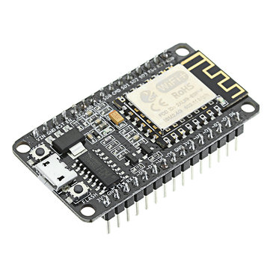
NodeMCU
Arduino compatible development board with built in 2.4Ghz Wifi
C/C++ or Lua programming environment
"Bread board friendly"
An open source IOT platform
Low cost

Slide 6
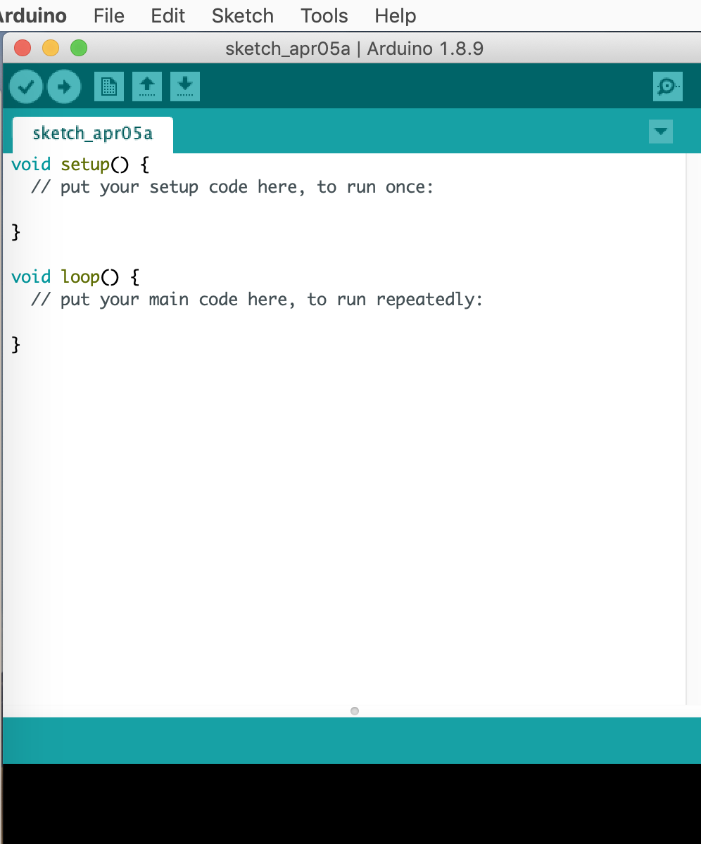
Arduino development environment

Slide 7
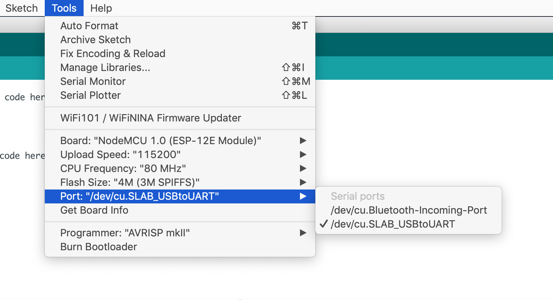
Select Serial Port and Board

Slide 8
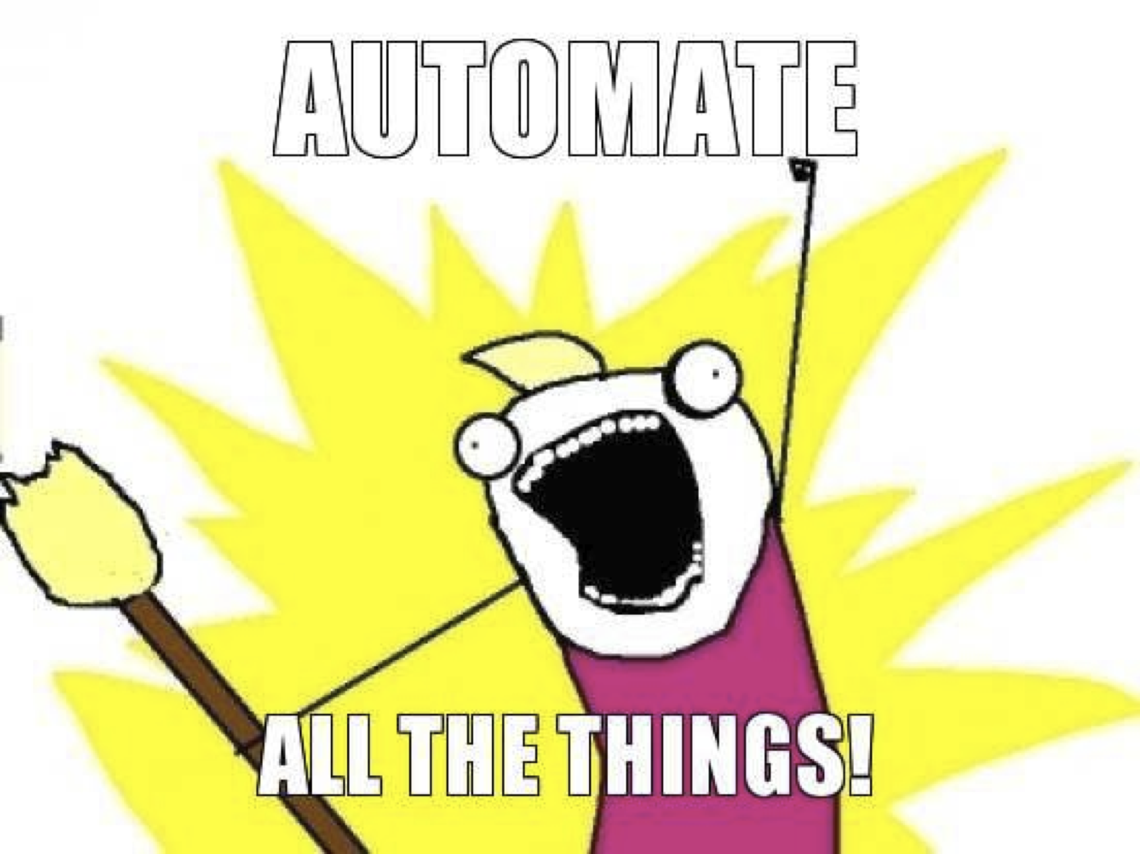
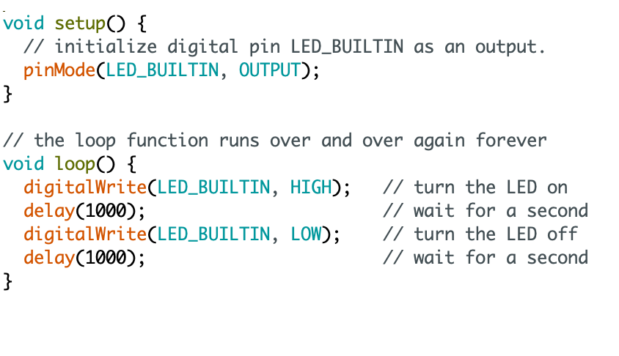
Our First Program
https://github.com/SophiaBelkin/BelkinCodingBootcamp/blob/master/examples/blinkLED/BlinkLED.ino
Notes:
Blink Example

Slide 9
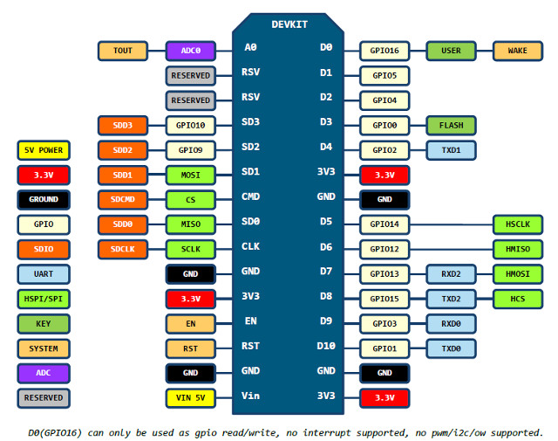
NodeMCU Pinout

Slide 10
Schematic

Slide 11
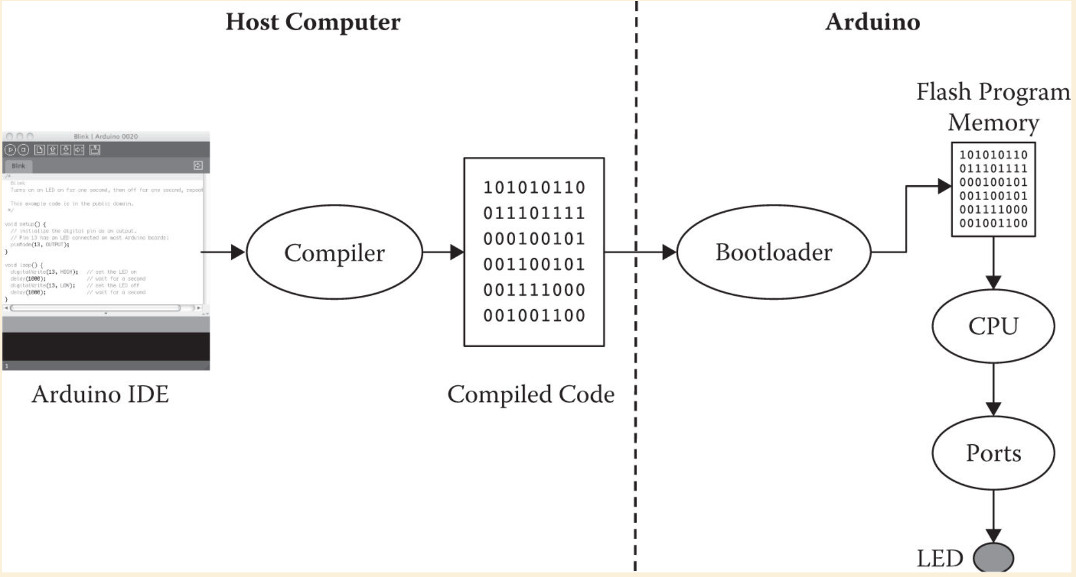

Slide 12
Basic C/C++ Embedded programming terms
Variable: Variables are the parts of the program used to hold different values. Similar to X, Y, and other letters In algebra problems
Loop: Loops are repeating sections of code, that may stop if certain criteria are met
VCC/+, GND/-: In electronics these are used to indicate the positive, and negative voltage and will show how current should flow through the electronics
Input / Output: The way that a computer receives or sends bits of information
GPIO/IO pins: General purpose input output pins can be used as input or output devices, and can be turned on or off, or can detect if a connected signal is turned on or off
Function: A function is a defined set of instructions that can be reused in a program without the programmer repeating the same instructions
Library: A collection of functions typically designed to specialize at some specific task

Slide 13
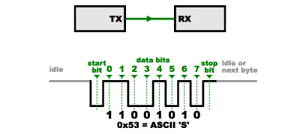
#2 Serial Communication
Serial.begin(9600)
Serial.print() or Serial.println()
Notes:
Probably only be able to explain the first two bullet points
-Explain what the '9600' means
Sets the data rate in bits per second (baud) for serial data transmission

Slide 14

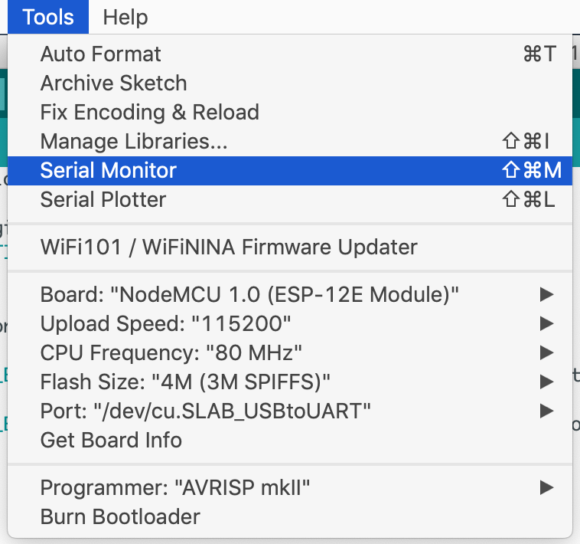
Serial Monitor

Slide 15
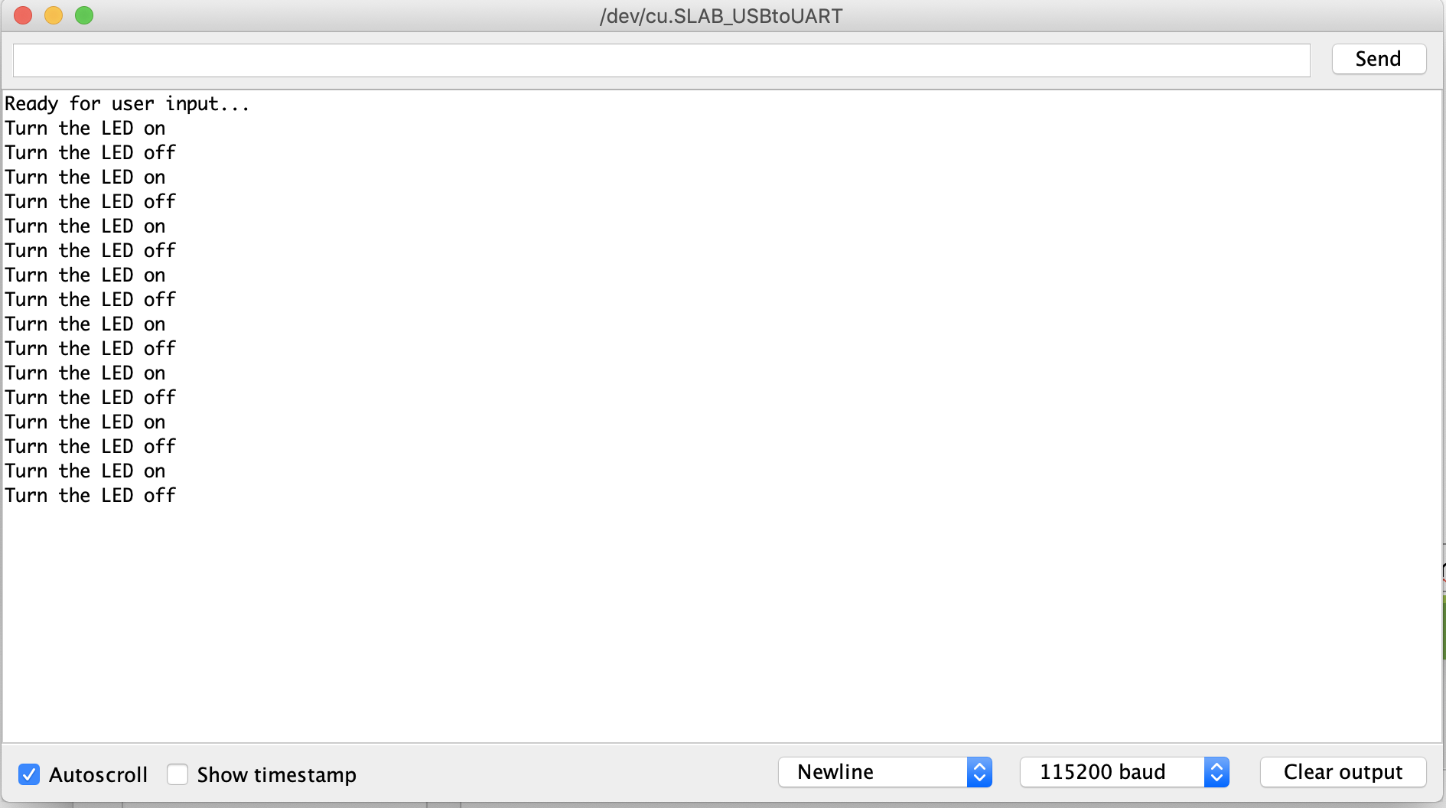
Serial Monitor
https://github.com/SophiaBelkin/BelkinCodingBootcamp/blob/master/examples/CommunicationSerial/CommunicationSerial.ino

Slide 16
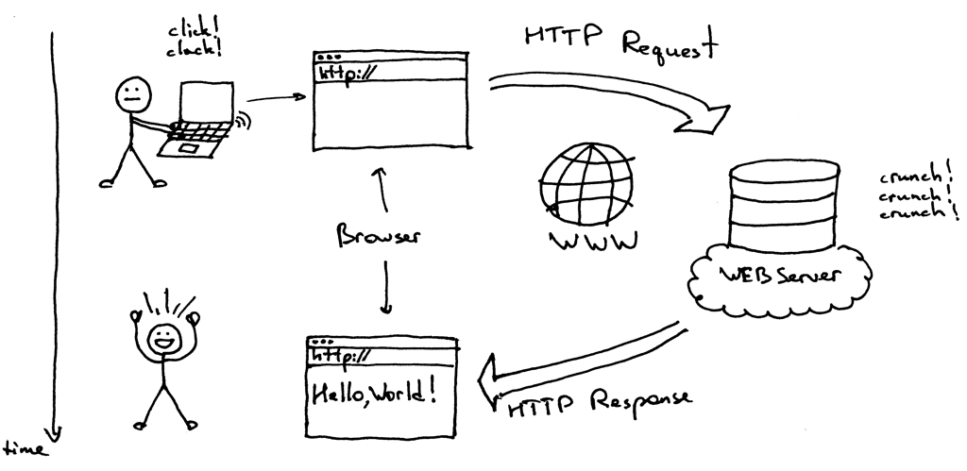
How does the Internet work ( Clients and Servers )
TCP/IP – A set of protocols for sending and receiving data using packets and addresses
Client – A program that ‘connects’ to servers to start communication web browsers are a client program
Server – A program that ‘accepts’ connections from client programs web servers handle connections from a web browser

Slide 17
#3 Setting a simple HTTP web server
Step 1: Configure the Arduino IDE to support the ESP8266
Step 2: Include ESP8266WiFi and ESP8266WebServer libraries
Step 3: declare a global object variable from ESP8266WebServer class
Step 4: Connect to the WiFi network with ESP8266
Step 5 : Get local IP address
Step 6: Specify the code to be execute when an HTTP request is performed on each path
Notes:
how to set a HTTP web server on a ESP8266
how to make some requests to it using a web browser

Slide 19
#4 Creating a WiFi / Web Controlled LED
Tutorial
http://www.instructables.com/id/Programming-ESP8266-ESP-12E-NodeMCU-Using-Arduino-/

Slide 20
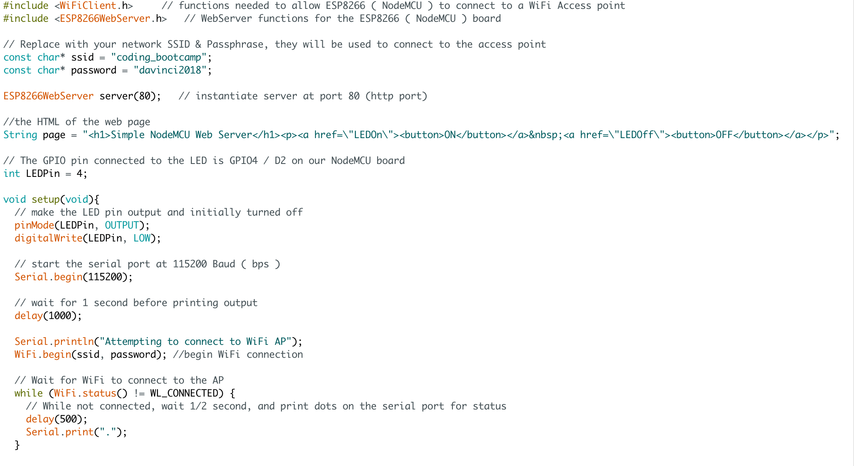

Slide 21
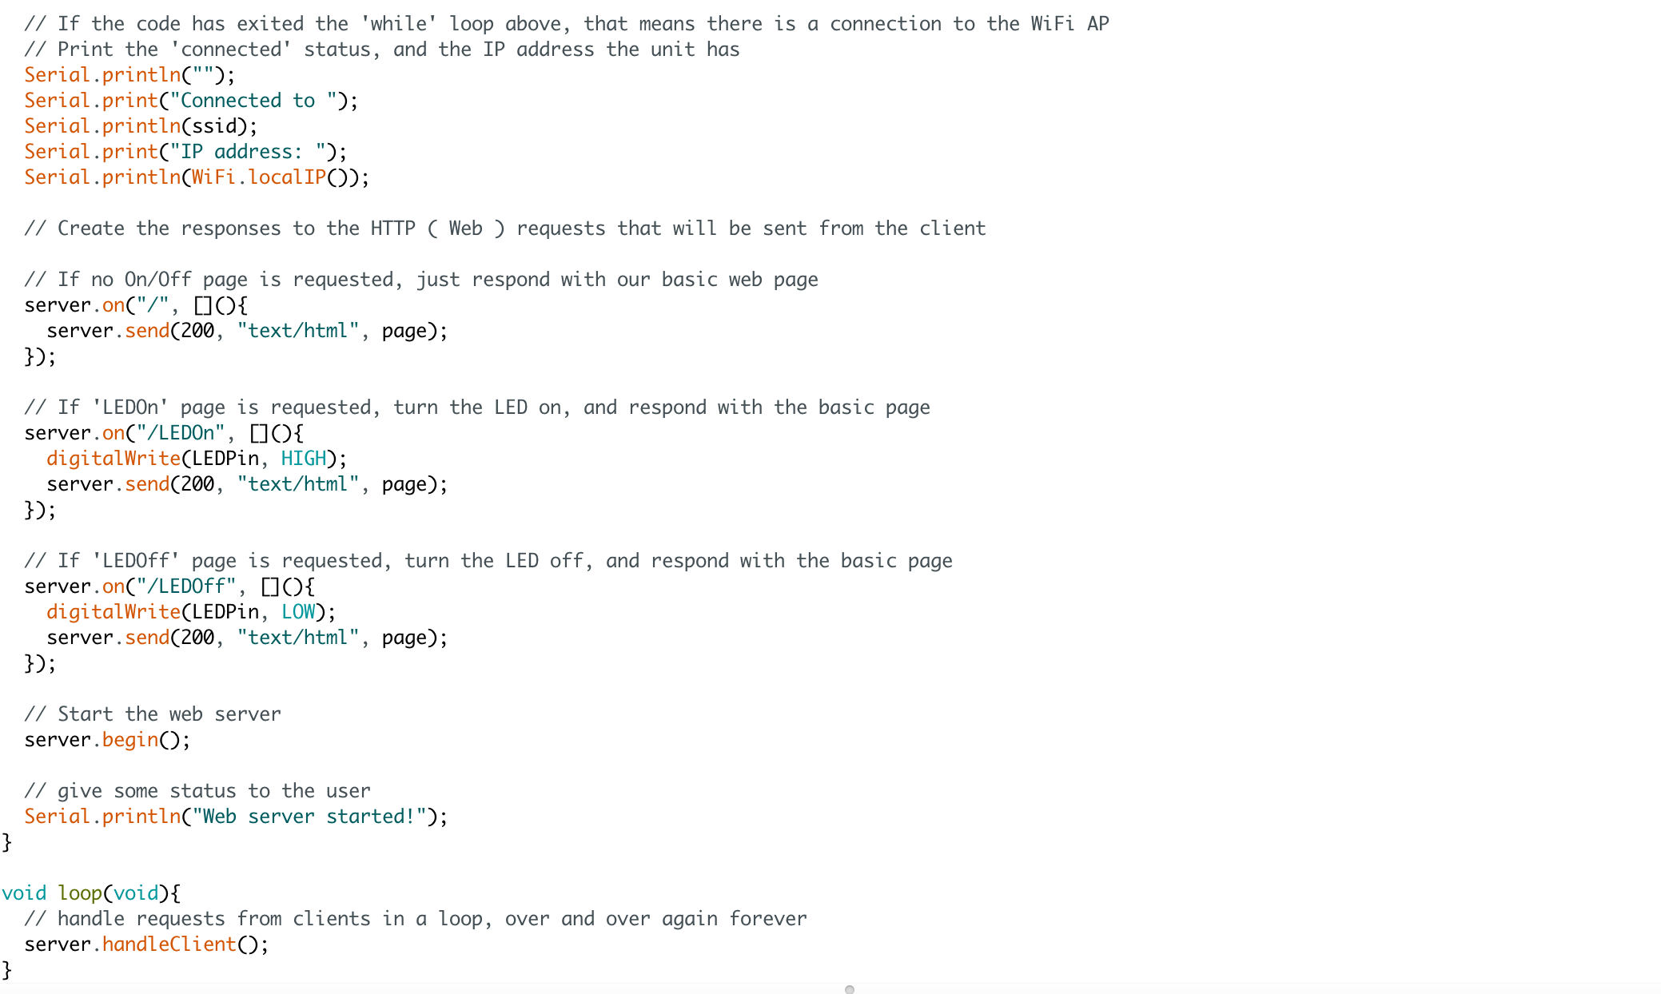

Slide 22

#5 Prototyping IoT with ESP8266 and IFTTT
Free platform that lets you create connection between different web-service and applications
Stands for ‘If this, then that’
A combination of a TRIGGER and an ACTION
Examples:
If the sensor was triggered, send me a message

Slide 23
Step 1: Setting Up the Components

Slide 24
Step 2: Getting Your Personal Key and Create Recipe
Free platform that lets you create connection between different web-service and applications
Stands for ‘If this, then that’
A combination of a TRIGGER and an ACTION
Examples:
If the sensor was triggered, send me a message

Slide 25
Get Started with
Create an account on https://ifttt.com/
Create an IFTTT Webhook

Slide 27
Glossary
Analog: An input or output that can send or receive a range of values
Digital: An input our output that can send or receive a value of 0 or 1 ( LOW, and HIGH )
Function: A defined section of code that executes a specific task.
Ground: The point of a circuit where there is 0 potential electrical energy. Without a ground, electricity will not have a place to flow in a circuit.
Serial monitor : A tool used to communicate with the Arduino board via the USB Serial port.

Slide 28
Links
https://www.arduino.cc/en/Main/Software - The official Arduino IDE
https://www.makerspaces.com/arduino-uno-tutorial-beginners/ - Arduino Beginner tutorial(s)
https://www.makeuseof.com/tag/getting-started-with-arduino-a-beginners-guide/
https://www.arduino.cc/en/tutorial/links - More Arduino programming links
http://www.oddwires.com/arduino-project-ideas/ - Arduino Project Ideas
https://www.hackster.io/Aritro/getting-started-with-esp-nodemcu-using-arduinoide-aa7267
https://github.com/greymattr/dvxBootcamp

Slide 29
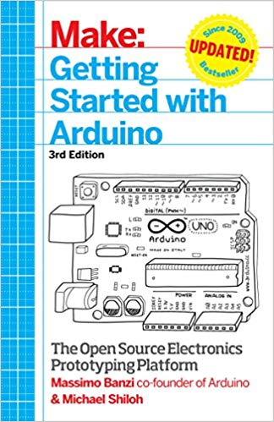
Further Reading
For Absolute Begineers
Getting Started with Arduino: The Open Source Electronics Prototyping Platform
by Massimo Banzi , Michael Shiloh
This is a beginner friendly book written based on the platforms's cofounder Massimo Banzi's expensive experience in teaching, using and building Ardunio

Slide 30
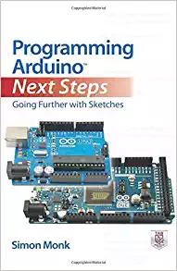
Further Reading
Take your skill to the next level
Programming Arduino Next Steps: Going Further with Sketches
by Simon Monk
Learn advanced Arduino programming techniques, including how to:
Program Arduino for the Internet
Maximizing serial communications
Managing memory
Performing dinital signal processing
Create and release your own code library

Slide 31

Further Reading
Take your skill to the next level
Electronics from the Ground Up: Learn by Hacking, Designing, and Inventing
by Ronald Quan
Guides you through step-by-step experiments that reveal how electronic circuits function.

Slide 32
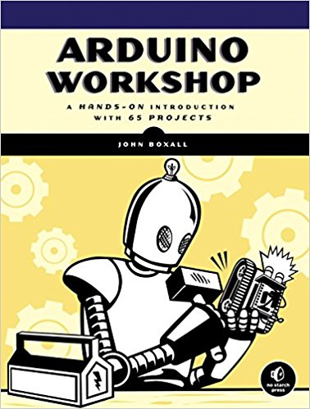
Further Reading
Fun project ideas
Arduino Workshop: A Hands-On Introduction with 65 Projects
by John Boxall
Among the book's 65 projects are useful devices like:
A digital thermometer that charts temperature changes on an LCD
A GPS logger that records data from your travels, which can be displayed on Google Maps
A handy tester that lets you check the voltage of any single-cell battery
A keypad-controlled lock that requires a secret code to open

Slide 33
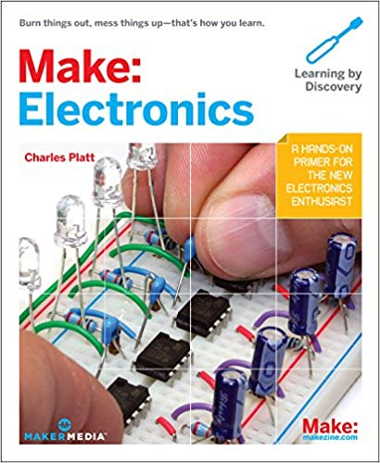
Further Reading
All about circuits and electrical components
Make:
Electronics
by Charles Platt
"Burn things out, mess things up-that's how you learn".
Learn about common electronic components
Circuit design, and creation
How to use a multimeter
Learn how to use the most popular IC's in projects

Slide 34
THANK YOU

